Slide 1

Automata Theory Lecture: 2 How to Define Languages
Farhad Muhammad Riaz

Slide 2
What are Languages
Introduction to languages
Formal Languages (Syntactic languages)
Base on some syntax.
Syntax is important
Check for errors
Informal Languages (Semantic languages)
Base on meaning
Check for meaning
Like type mismatch

Slide 3
What is Automata Theory?
Study of abstract computing devices, or “machines”
Automaton = an abstract computing device
Note: A “device” need not even be a physical hardware!
A fundamental question in computer science:
Find out what different models of machines can do and cannot do
The theory of computation
Computability vs. Complexity

Slide 4
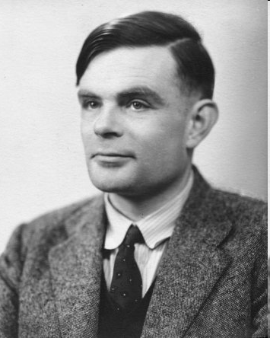
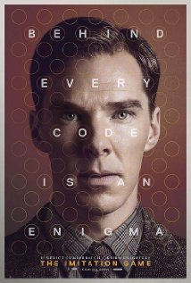
Alan Turing (1912-1954)
(A pioneer of automata theory)
Father of Modern Computer Science
English mathematician
Studied abstract machines called Turing machines even before computers existed
Heard of the Turing test?

Slide 5
Theory of Computation: A Historical Perspective
1930s
Alan Turing studies Turing machines
Decidability
Halting problem
1940-1950s
“Finite automata” machines studied
Noam Chomsky proposes the “Chomsky Hierarchy” for formal languages
1969
Cook introduces “intractable” problems or “NP-Hard” problems
1970-
Modern computer science: compilers, computational & complexity theory evolve

Slide 6
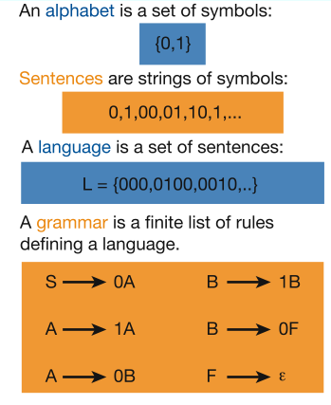
Languages & Grammars
Languages: “A language is a collection of sentences of finite length all constructed from a finite alphabet of symbols”
Grammars: “A grammar can be regarded as a device that enumerates the sentences of a language” - nothing more, nothing less
N. Chomsky, Information and Control, Vol 2, 1959
Image source: Nowak et al. Nature, vol 417, 2002

Slide 7
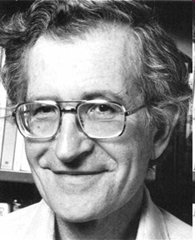
The Chomsky Hierachy
A containment hierarchy of classes of formal languages
Context- sensitive (LBA)
Context- free
(PDA)
Regular
(DFA)
Recursively- enumerable (TM)

Slide 8
Alphabet
An alphabet is a finite, non-empty set of symbols
We use the symbol ∑ (sigma) to denote an alphabet
Examples:
Binary: ∑ = {0,1}
All lower case letters: ∑ = {a,b,c,..z}
Alphanumeric: ∑ = {a-z, A-Z, 0-9}
DNA molecule letters: ∑ = {a,c,g,t}
…

Slide 9
Strings
A string or word is a finite sequence of symbols chosen from ∑
Empty string is ε (or “epsilon”)
Length of a string w, denoted by “|w|”, is equal to the number of (non- ε) characters in the string
E.g., x = 010100 |x| = 6
x = 01 ε 0 ε 1 ε 00 ε |x| = ?
xy = concatentation of two strings x and y

Slide 10
Word and Valid/In-valid alphabets
Words
Words are strings belonging to some language
All words are strings, but not all strings are words.
Example solve on Board
Valid/In-valid alphabets
While defining an alphabet of letters consisting of more than one symbols, no letter should be started with any other the letter of the same alphabet i.e. one letter should not be the prefix of another. However, a letter may be ended in the letter of same alphabet i.e. one letter may be the suffix of another
Σ= { a , b } ( Valid Alphabet)
Σ= { a , b , cd } ( Valid Alphabet)
Σ= { a , b , ac } ( Invalid Alphabet)

Slide 11
Length of Strings
Length of Strings
The length of string s, denoted by |s|, is the number of letters in the string
∑={a,b}
s=ababa
|s|=5
∑= {B, aB, bab, d}
s=BaBbabBd
What is the Length of This String ?

Slide 12
Reverse of String
Reverse of String
Reverse of a string s denoted by Rev(s) or sr, is obtained by writing the letters of s in reverse order.
If s=abc is a string defined over ∑={a,b,c}
then Rev(s) r = cba
∑= {B, aB, bab, d}
s=BaBbabBd
What the Rev(s)

